Slide 1







ELECTRONIC
RECYCLING
By :-
* Waleed Radwan
* Mayar Rakha
* Mina Nasr
* Randa Al-ansary
* Hala Khaled
* Yomna Meles

Slide 2
TABLE OF CONTENTS
Intro
Project Objectives
Requirements
Project Manager Info
Milestones
Timeline
Budget
Investment Highlight
Conclusion

Slide 3
Introduction
The electronic waste recycling project aims to reduce environmental pollution by managing electronic waste, which contains hazardous materials that can harm the ecosystem.
Through recycling, the project seeks to recover valuable materials, such as metals and rare earth elements, that can be reused in new products, thus reducing the demand for raw materials.
Electronic waste recycling not only protects the environment but also creates economic opportunities, providing new jobs and contributing to a circular economy.
By adopting this recycling approach, we aim to create a safer and cleaner environment while supporting the growing global demand for sustainable and eco-friendly solutions.

Slide 4

PROJECT OBJECTIVES
Objective 1: Set up an electronic waste collection, sorting, and recycling system.
Objective 2: Implement effective recycling methods to recover valuable materials.
Objective 3: Create job opportunities and educate the community.
Objective 4: Achieve compliance with environmental regulations.

Slide 5


REQUIRMENTS
Facility layout and design.
Recycling Process & Equipment.
Manpower.
Obtaining Permits and Licenses.
Establishing E-Waste Supply Sources.

Slide 6



Project phases
Planning and Feasibility Study.
Design and Engineering.
Legal Approvals and Funding.
Construction.
Staffing and Training.
Operations Setup.
Marketing and Distribution.
Launch and Scaling.
Monitoring and Sustainability.

Slide 7

PROJECT MANAGER INFO
•Name: Waleed Radwan
•Responsibilities:
Planning, supervising, coaching.
Ensuring quality, risk management.
Training, decision-making, assigning contracts.

Slide 8

Tools we use
Microsoft Project

Slide 9
MILESTONES
12-Months Timeline:
3rd month : Facility Design & Permits
6th month : Equipment Installation
9th month : Hiring & Training
12th month : Full Operations

Slide 10


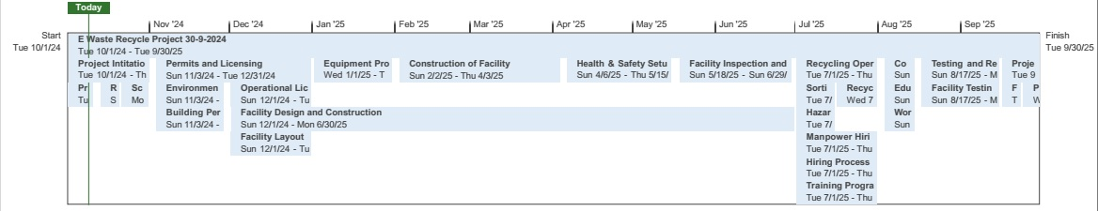

TIMELINE

Slide 11

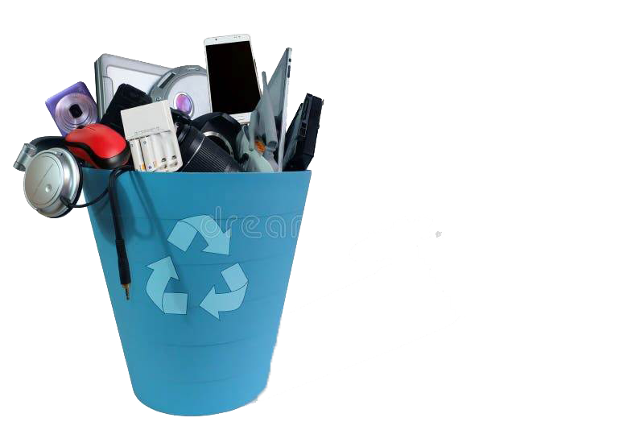
BUDGET
•Estimated Cost: about 7,300,000 EGP
(7,349,667 EGP)
•Breakdown:
Facility: 306,667 EGP
Equipment: 4,831,000 EGP
Manpower: 2,162,000 EGP
Permits & Licenses: 50,000 EGP

Slide 12


INVESTMENT HIGHLIGHTS
Market Potential: Growing demand for electronic recycling.
Green Environment: Reduce Electronic Wastes hazards
Revenue Streams: Recovered materials, government incentives, partnerships.
Social Impact: Job creation, community engagement.
Sustainability: Compliance with environmental regulations.

Slide 13
CONCLUSION
•SUMMARY: RECAP OF PROJECT OBJECTIVES AND BENEFITS.
CALL TO ACTION: ENCOURAGE INVESTMENT FOR A SUSTAINABLE FUTURE

Slide 14

THANK YOU!

